Slide 1

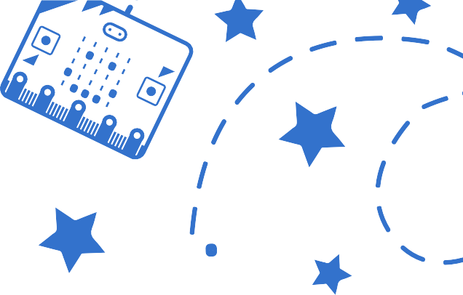
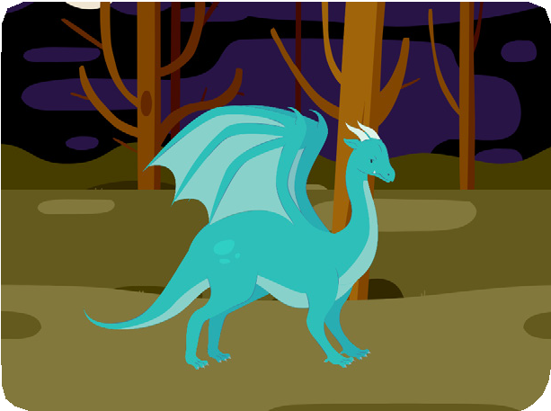
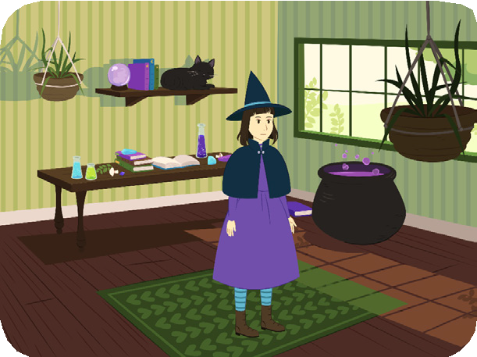
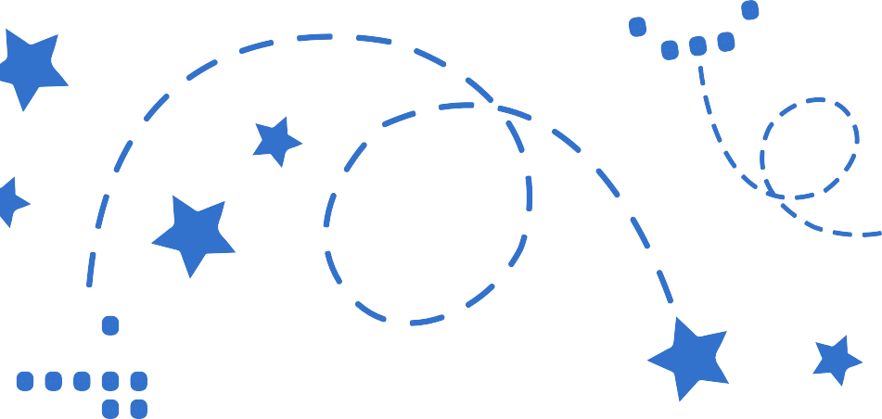
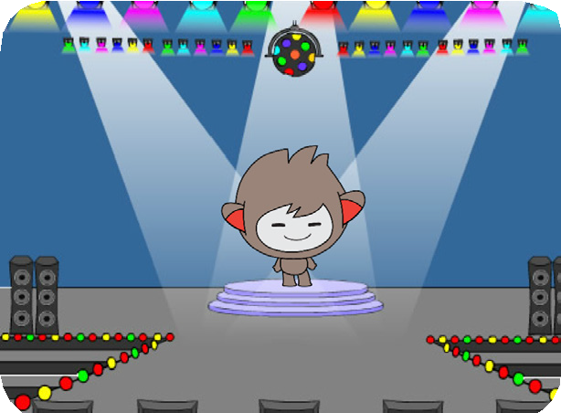
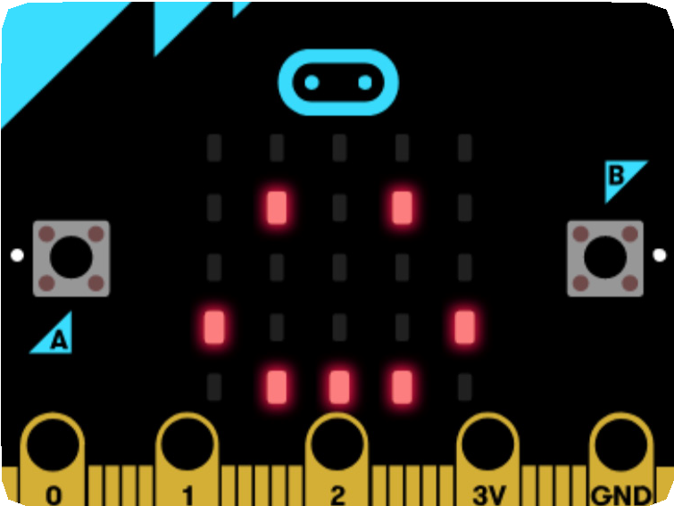

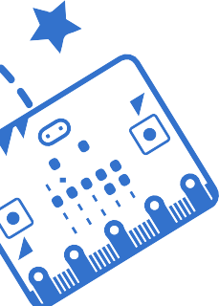

micro:bit Cards
A
B
B
Make projects that connect to the physical world with micro:bit!
yyyymmdd
scratch.mit.edu/microbit
Set of 7 cards
A

Slide 2
micro:bit Cards
A
B
B
Try these cards in any order:
Cast a Spell
Squeak
Move Around
Press a Button
Jump
Move Back and Forth
Create an Emoji
bit.ly/scratchbit
Set of 7 cards
A

Slide 3
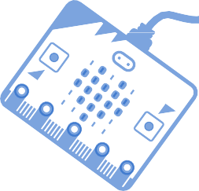
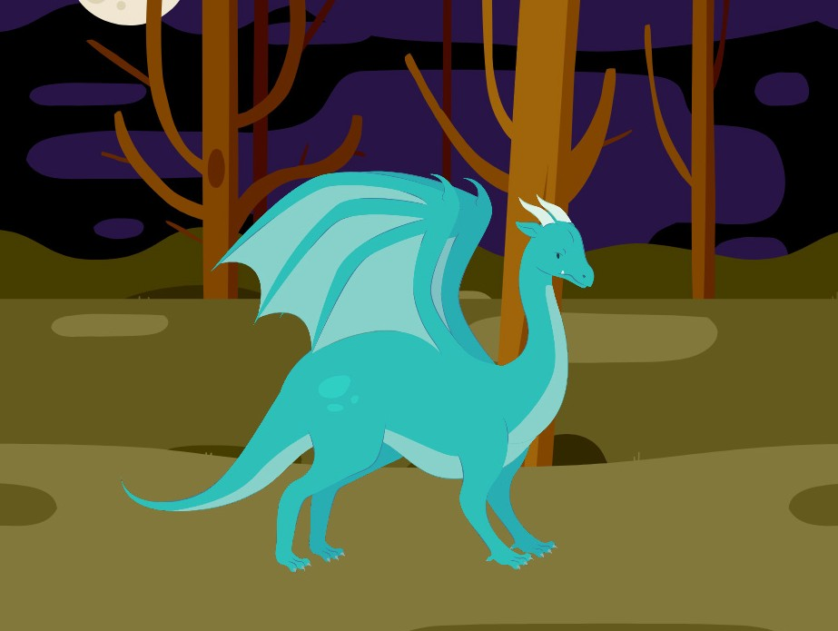
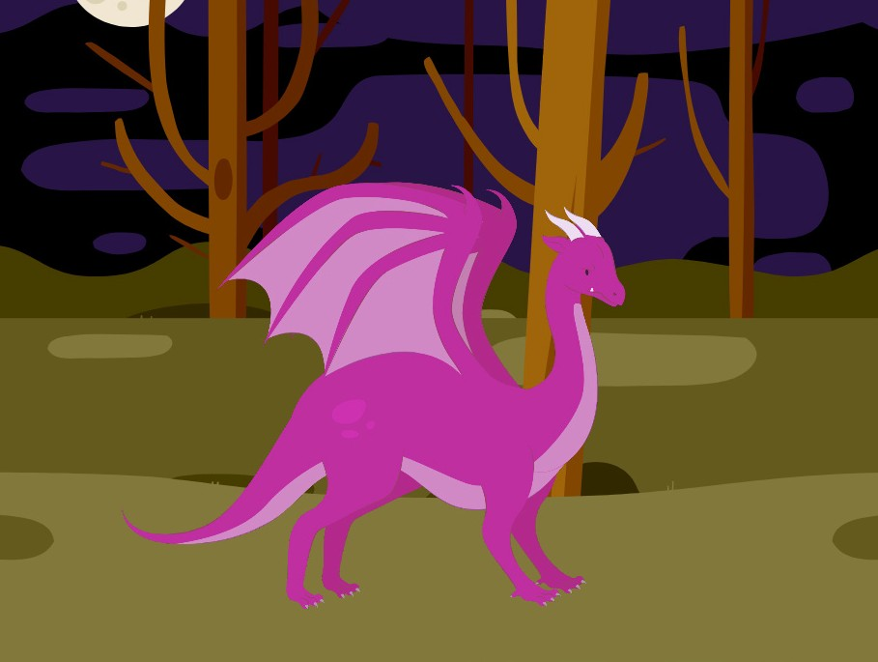

Cast a Spell
A
B
Make something happen when you move the micro:bit.
yyyymmdd
micro:bit
1

Slide 4

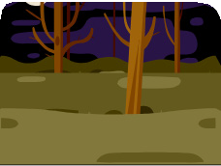



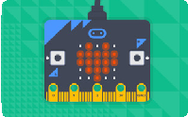
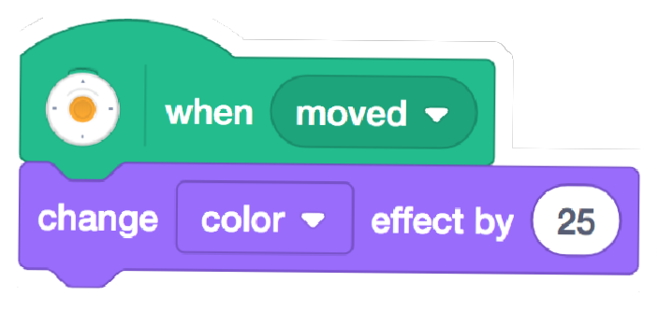


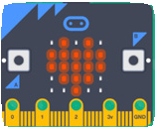
Cast a Spell
scratch.mit.edu/microbit
A
B
GET READY
Choose a backdrop.
Woods
Choose a sprite.
Dragon
Click the Extensions button.
Then, click to add the micro:bit extension.
ADD THIS CODE
Dragon
TRY IT
Move the micro:bit to start.

Slide 5
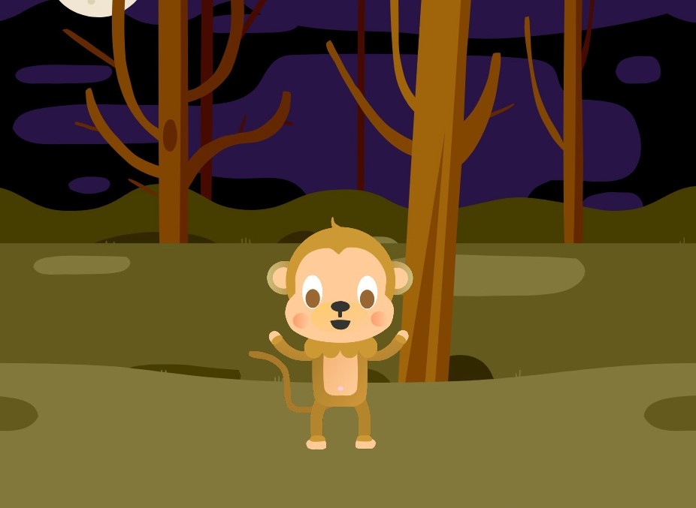
Squeak
A
B
Make a sound when you shake the micro:bit.
yyyymmdd
micro:bit
2

Slide 6


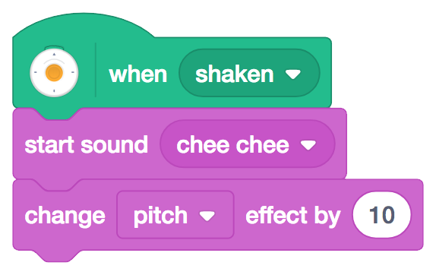


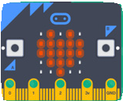
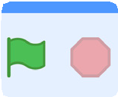


Squeak
scratch.mit.edu/microbit
A
B
GET READY
Monkey
Choose a sprite, like Monkey.
ADD THIS CODE
Monkey
TRY IT
Shake the micro:bit to start.
Click the stop sign to reset the pitch.
TIP
You can click the Sounds tab to view your character's sounds.
Click this button to add a sound from the Sound library.

Slide 7
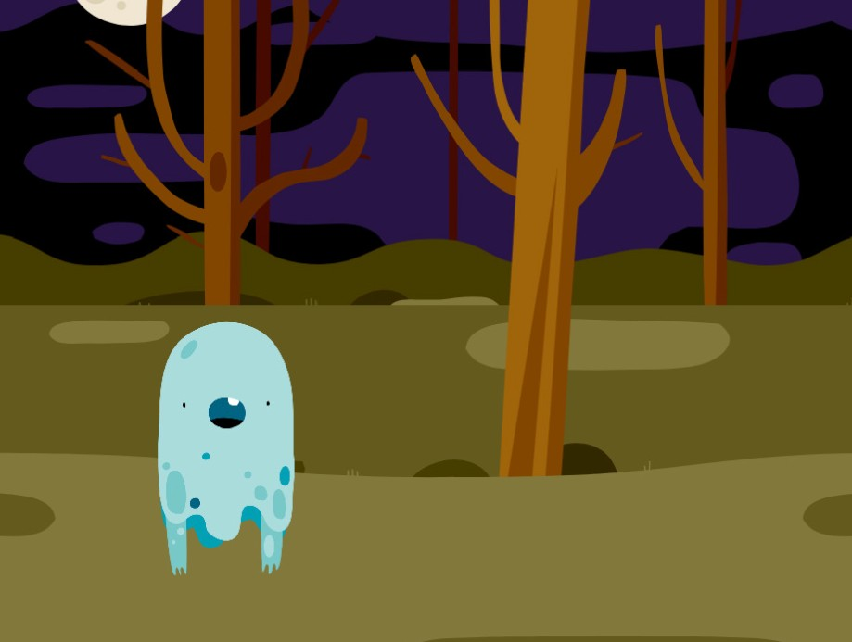
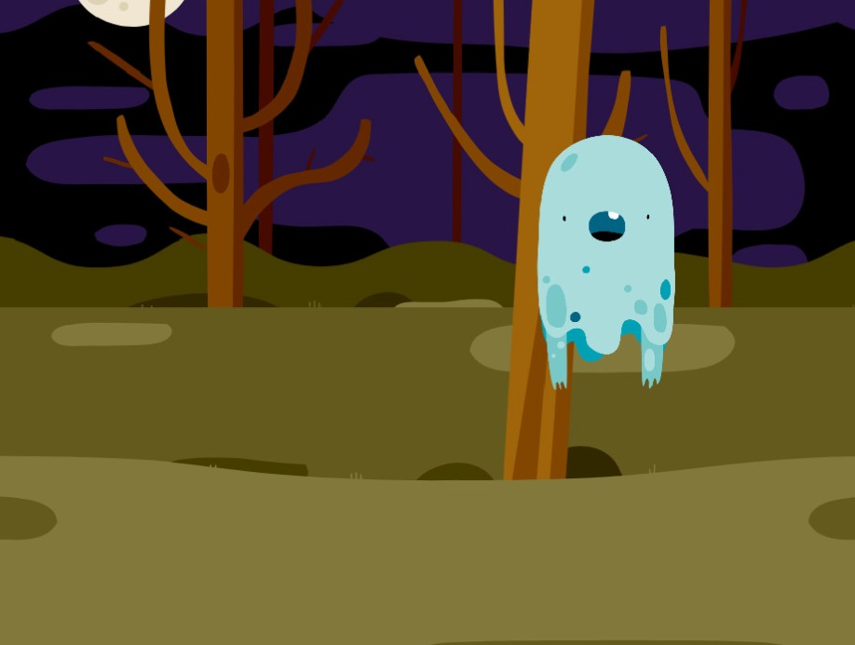
Move Around
A
B
Make a character glide around the screen.
yyyymmdd
micro:bit
3

Slide 8

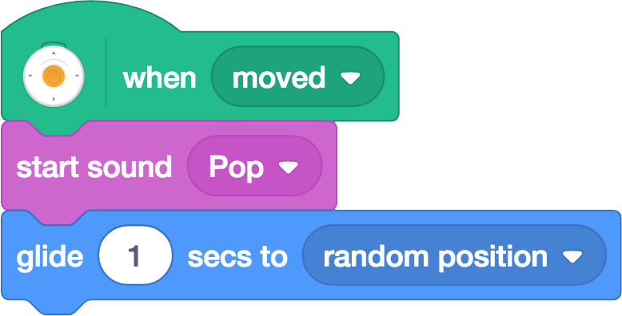


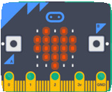
Move Around
scratch.mit.edu/microbit
A
B
GET READY
Ghost
Choose a sprite, like Ghost.
ADD THIS CODE
Ghost
To move faster, type a smaller number, like 0.5
TRY IT
Move the micro:bit to start.

Slide 9
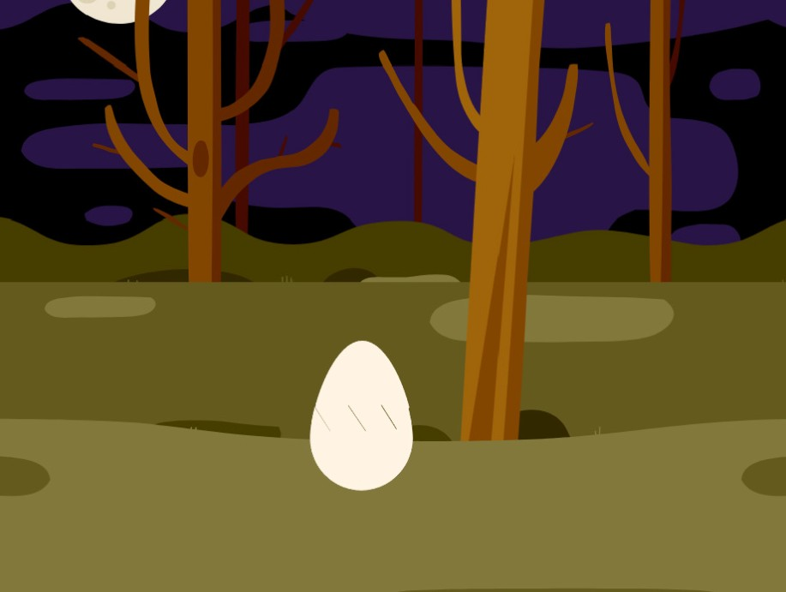
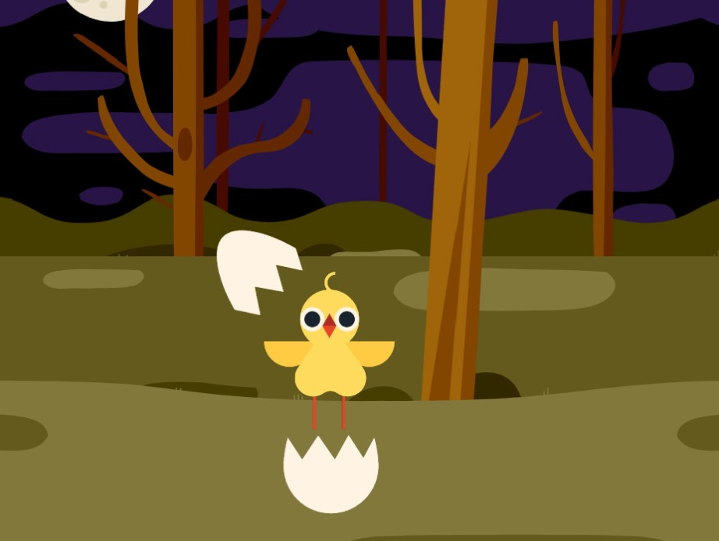
Press a Button
A
B
Make something happen when you press the micro:bit button.
yyyymmdd
micro:bit
4

Slide 10
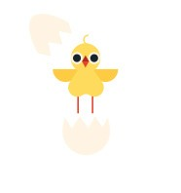



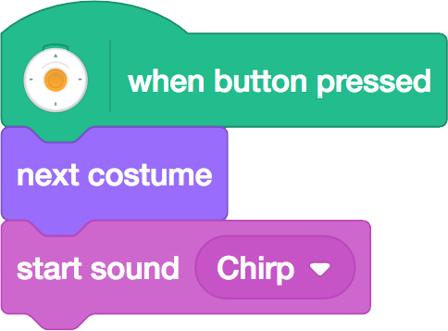
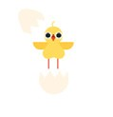

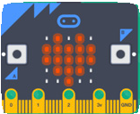
Press a Button
scratch.mit.edu/microbit
A
B
GET READY
Click the
tab.
Hatchling
Choose a sprite with multiple costumes, like Hatchling.
Choose a sound, like Chirp.
ADD THIS CODE
Click the tab.
Hatchling
Choose your sound from the menu.
TRY IT
Press the A button on the micro:bit to start.

Slide 11
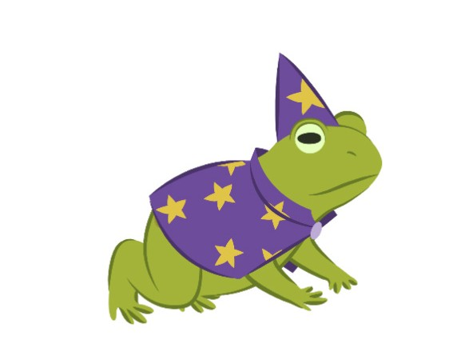
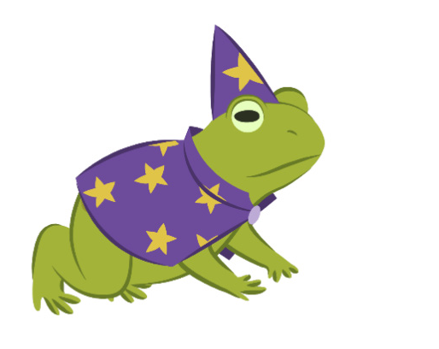
Jump
A
B
Have a character jump up and down.
yyyymmdd
micro:bit
5

Slide 12
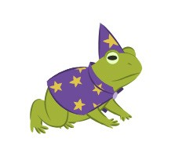
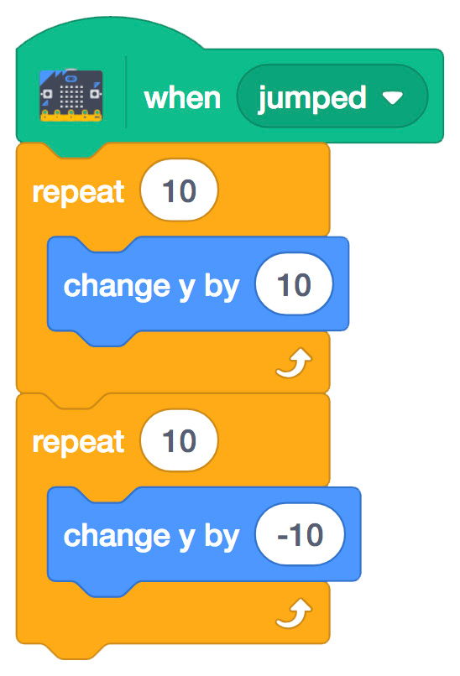
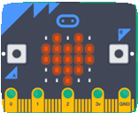
Jump
scratch.mit.edu/microbit
A
B
GET READY
Wizard-toad
Choose a sprite, like Wizard-toad.
ADD THIS CODE
Type a minus sign to move down.
TRY IT
Jump with the micro:bit to start.

Slide 13
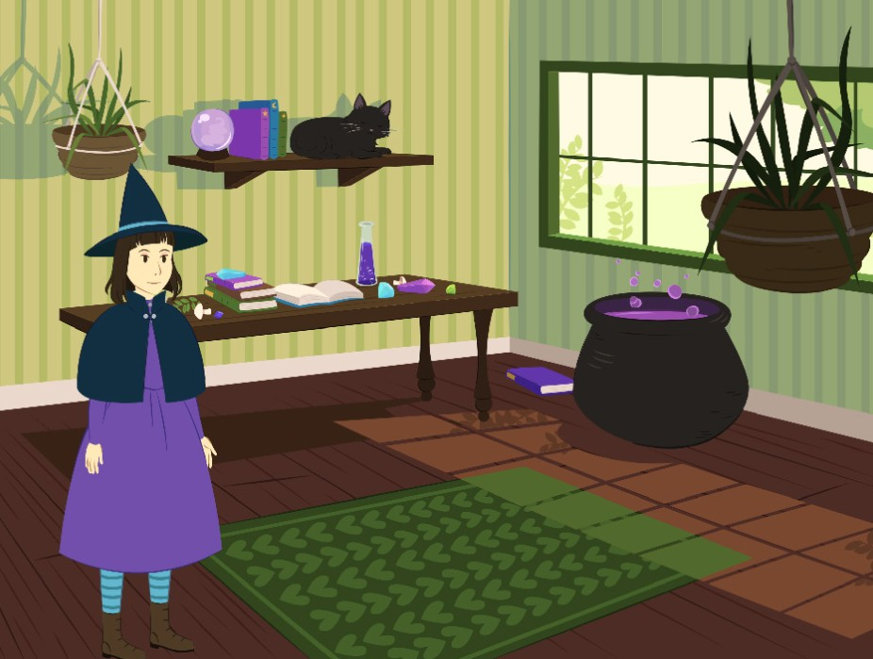
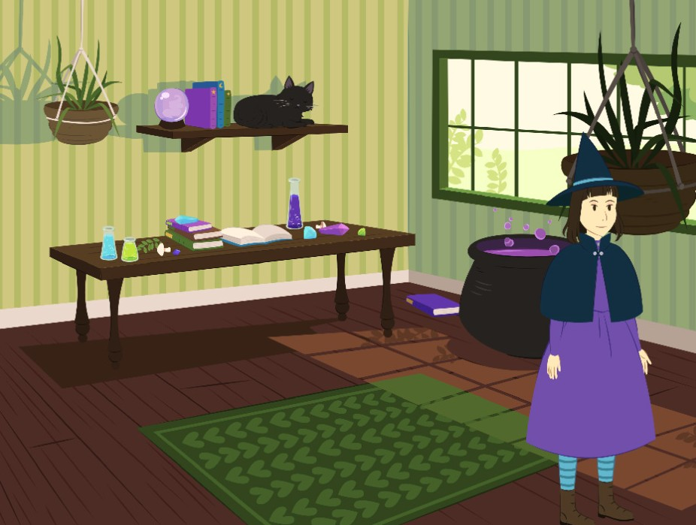
Move Back and Forth
A
B
Move a character from side to side when you tilt the micro:bit.
yyyymmdd
micro:bit
6

Slide 14
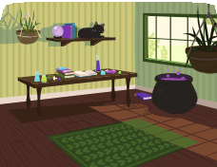
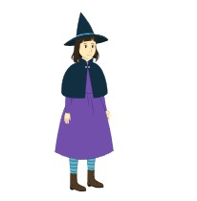


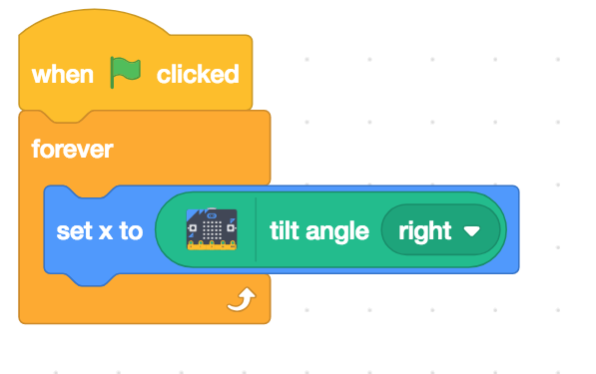
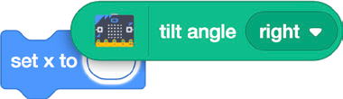
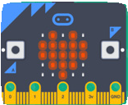
Move Back and Forth
scratch.mit.edu/microbit
A
B
GET READY
Witch House
Witch
Choose a backdrop, like Witch House
Choose a sprite, like Witch
ADD THIS CODE
Witch
Insert the tilt angle block into the set x block.
TRY IT
Tilt the micro:bit to move your character from side to side.

Slide 15
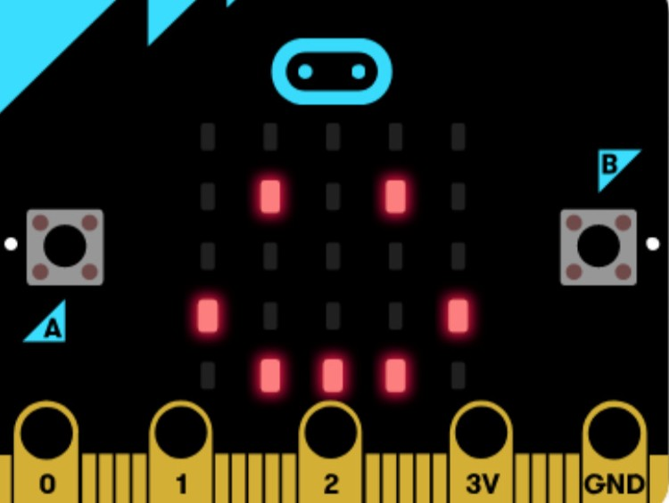
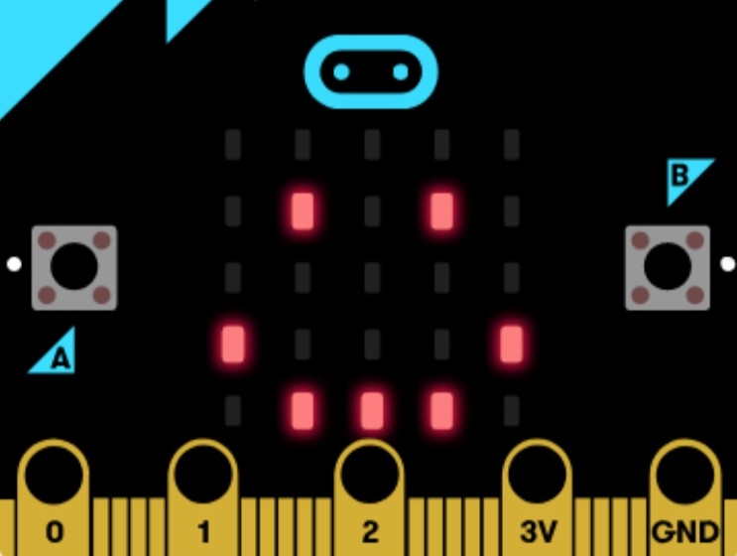










Create an Emoji
A
B
Make your own emoji on the micro:bit display.
yyyymmdd
micro:bit
7

Slide 16
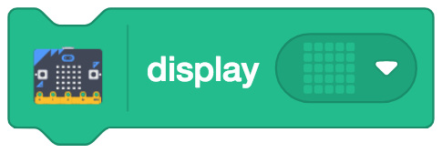
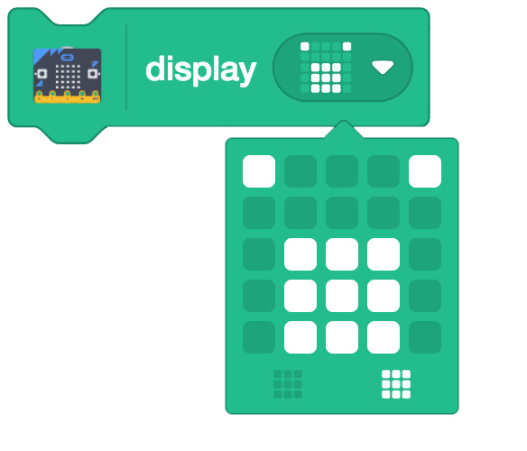
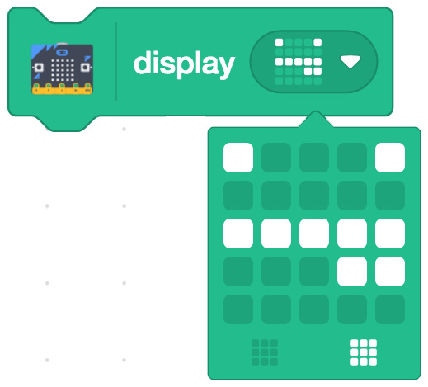
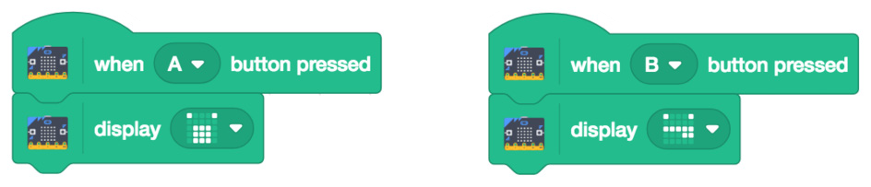
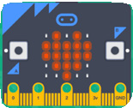
Create an Emoji
scratch.mit.edu/microbit
A
B
GET READY
Drag out a
block and click on the grid.
Click the individual squares to turn them on or off in your design.
ADD THIS CODE
TRY IT
A
B
Press the A and B buttons to show your emojis on the micro:bit.

